Slide 1
Developing Apps for Touch and Mobile Devices

Slide 2
Objectives
In this session, you will learn to:
  Create wireframes for mobile apps
  Identify navigation patterns

Slide 3
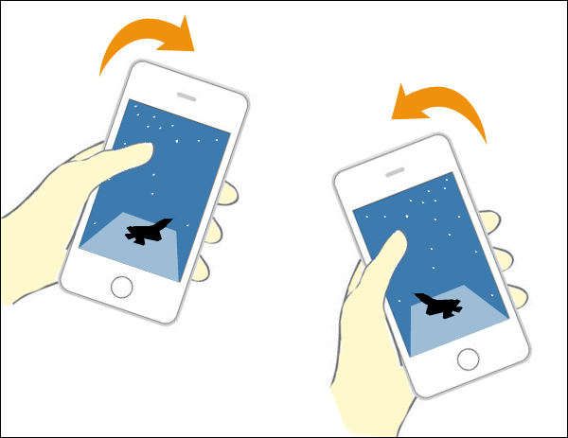
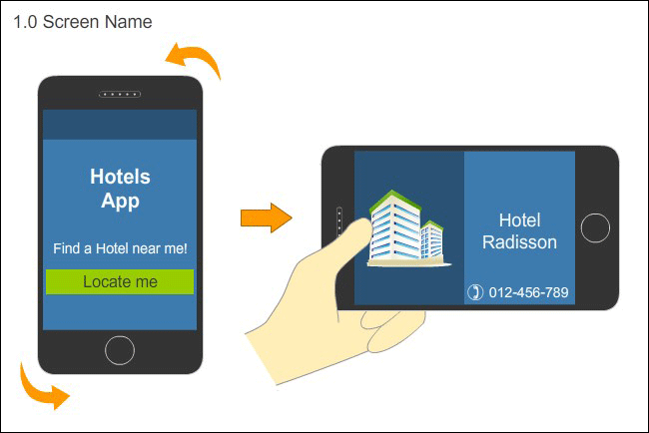
Wireframing for Other Cases
Representing Motion
When you are designing an app that uses the accelerometer, you need to represent the interactions that are generated using the accelerometer.
This representation can be made by depicting the initial state and the final state of the device.
You need to use arrows to depict the direction of the movement of the device.
Motion Representation of Device
Representation of Rotation in
Wireframe

Slide 4
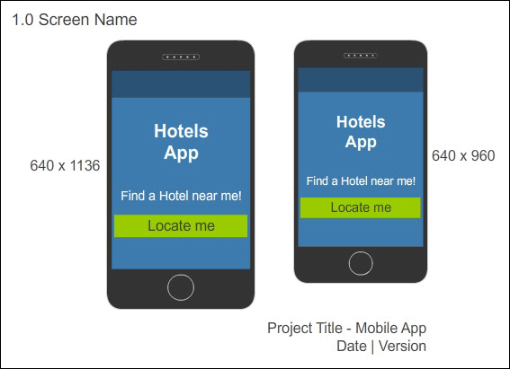
Wireframing for Other Cases (Contd.)
Representing Multiple Devices
When designing an app for multiple devices, such as an iPhone or iPad, you should ensure that the mobile experience fits well in different screen sizes.
You need to create multiple designs for the app so that it can be viewed properly on both the devices.
To handle different screen sizes, you need to use a combination of wireframes and annotations.
Wireframe for Multiple Screen Sizes

Slide 5
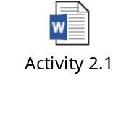
Activity 2.1: Creating Wireframes
Problem Statement:

Slide 6
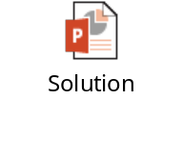
Activity 2.1: Creating Wireframes (Contd.)
Solution:

Slide 7


Identifying Navigation Patterns

Slide 8
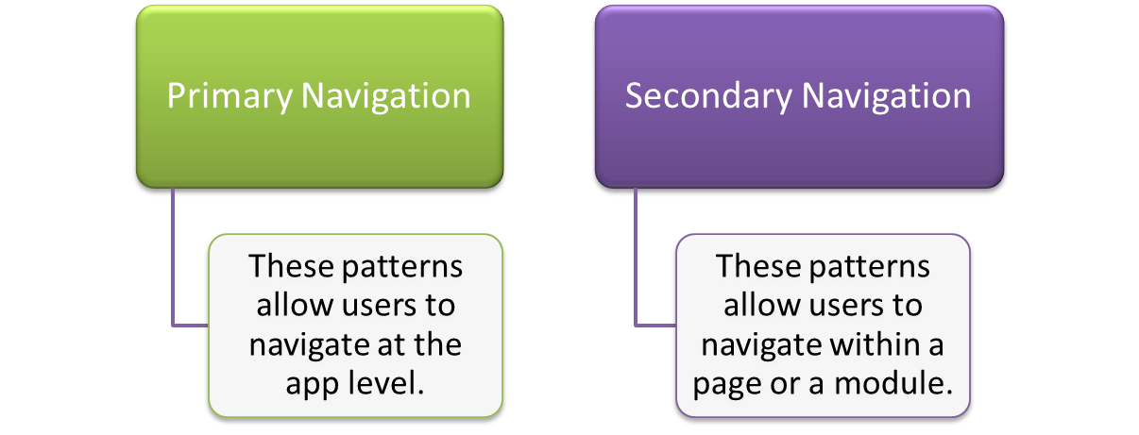
Identifying Navigation Patterns (Contd.)
Navigation means finding a way with the help of signs and landmarks.
Navigation in mobile apps helps users to identify where they are, how they need to proceed further, or how they can visit the previous screen.
Navigation patterns help UX designers to:
  Implement navigation in mobile apps.
  Allow users to navigate the app with ease.
Navigation patterns are of two types:

Slide 9
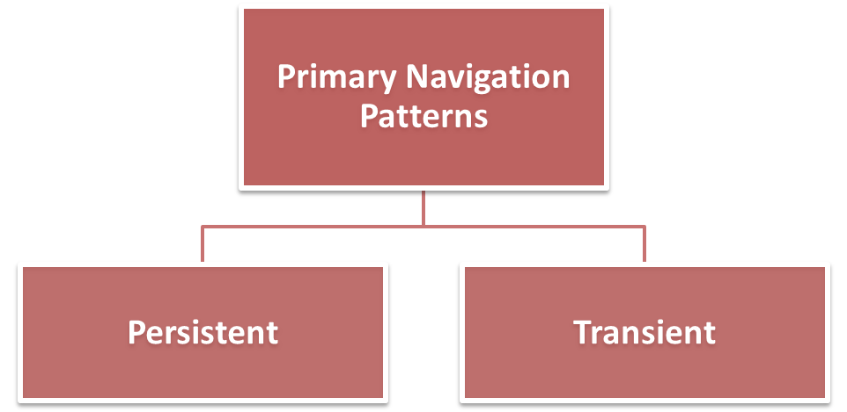
Primary Navigation Patterns
Primary navigation patterns are used for primary navigation, such as
top-level menus or main menu.
These patterns contain menu options that enable users to navigate from one parent category to another.
Some of these patterns are displayed for a considerably long time to allow users to make a selection.
Some of these patterns are hidden and accessible to users through a gesture.

Slide 10
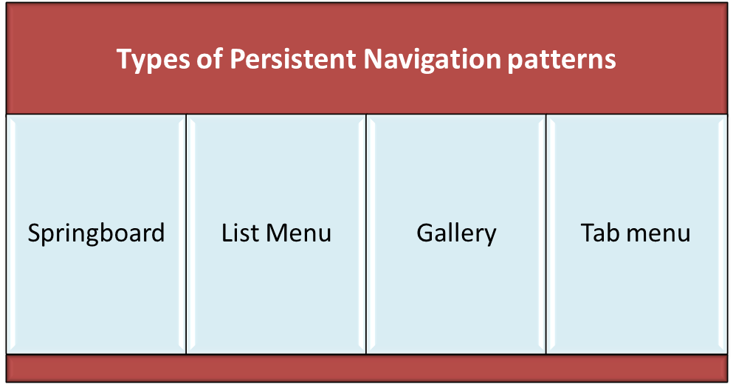
Primary Navigation Patterns (Contd.)
Persistent Navigation Patterns
When an app launches, persistent navigation patterns are displayed to users.
These patterns are known as persistent, meaning continuous existence because they remain accessible to users throughout the app.

Slide 11
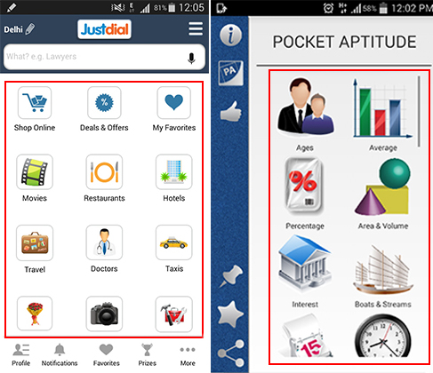
Primary Navigation Patterns (Contd.)
Persistent Navigation Patterns (Contd.)
Springboard is one of the popular
mobile navigation patterns due to its capability of functioning in a similar manner across diverse mobile devices.
Springboard provides users with a
screen consisting of a number of menu options of equal importance in a grid format.
Each menu option in a springboard allows users to launch an application.
Examples of Springboards

Slide 12
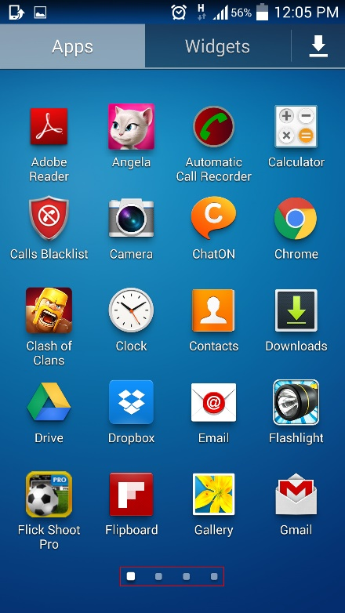
Primary Navigation Patterns (Contd.)
Persistent Navigation Patterns (Contd.)
Springboard is also known as Launchpad.
A springboard can contain a large number of options that cannot fit into a single screen.
Paging indicators can be used to enable users to view all the available options of a springboard.
Users can swipe the page to view other options.
Springboard with
Paging Indicators

Slide 13

Primary Navigation Patterns (Contd.)
Persistent Navigation Patterns (Contd.)
The UX designers customize the default, consistent proportion grid layout of a springboard.
To emphasize one or more options, say a video option, UX designers need to bring inconsistency in the default grid layout.
Customized Springboard

Slide 14
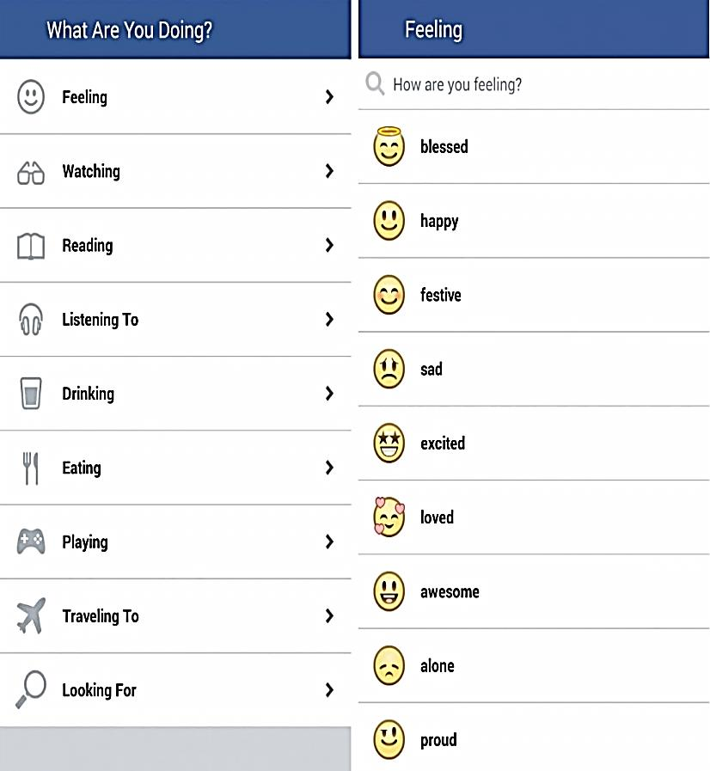
Primary Navigation Patterns (Contd.)
Persistent Navigation Patterns (Contd.)
The list menu is used where hierarchical navigation is required. Hierarchical navigation enables users to navigate from one screen to another making a choice per screen.
In hierarchical navigation, you need to select an option on each screen to complete a task.
For hierarchical navigation, you use the List menu.
List Menu

Slide 15
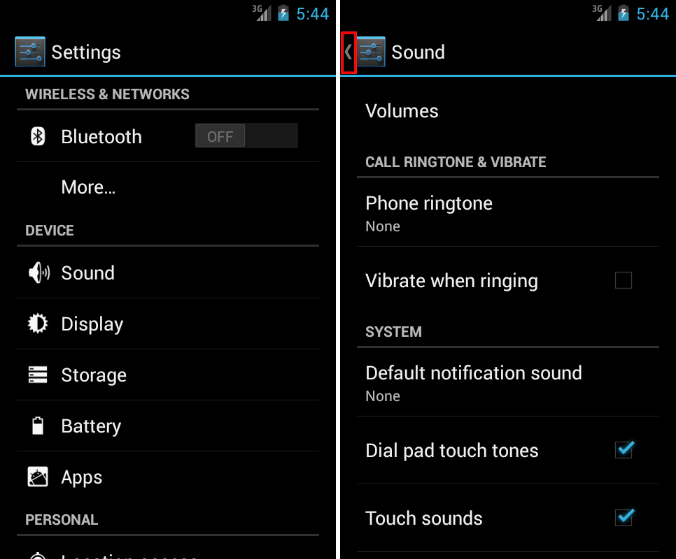
Primary Navigation Patterns (Contd.)
Persistent Navigation Patterns (Contd.)
The hardware Back button on the device or the Back button at the
top-left corner of the screen serves the purpose of going back to the previous screens.
In case there is no hardware button (like iOS devices), the Back button at the top-left corner of the screen is the only option to go back to the previous screen.
In Android, this Back button is known as the Up button.
Up Button

Slide 16
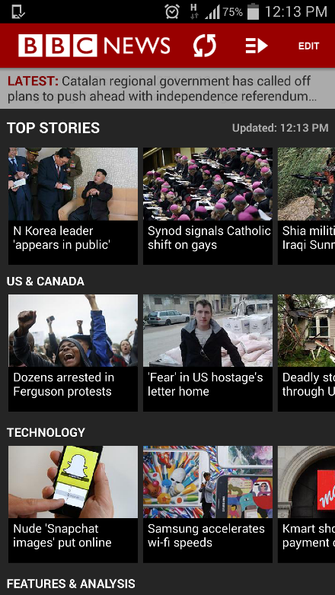
Primary Navigation Patterns (Contd.)
Persistent Navigation Patterns (Contd.)
A gallery is a design pattern that consists of a number of images in a grid format with or without text.
Each image, when selected, displays the corresponding live information, which is frequently updated information, such as news and recipes.
The gallery displays live information, so it is used to display frequently updated information with dynamic visuals to the users.
Gallery is useful in news apps.
Gallery Design Pattern

Slide 17

Primary Navigation Patterns (Contd.)
Persistent Navigation Patterns (Contd.)
Tab bar also known as the tab menu, provides various primary options to users to quickly find the information related to an app.
Tab bar in mobile apps can contain a maximum of five items that are represented through icons.
In case more than five items need to be included on a tab bar, a More icon is added.
More icon, when tapped, provides other options that cannot fit on the tab bar.
App Bar of Windows Phone
with the More Icon

Slide 18
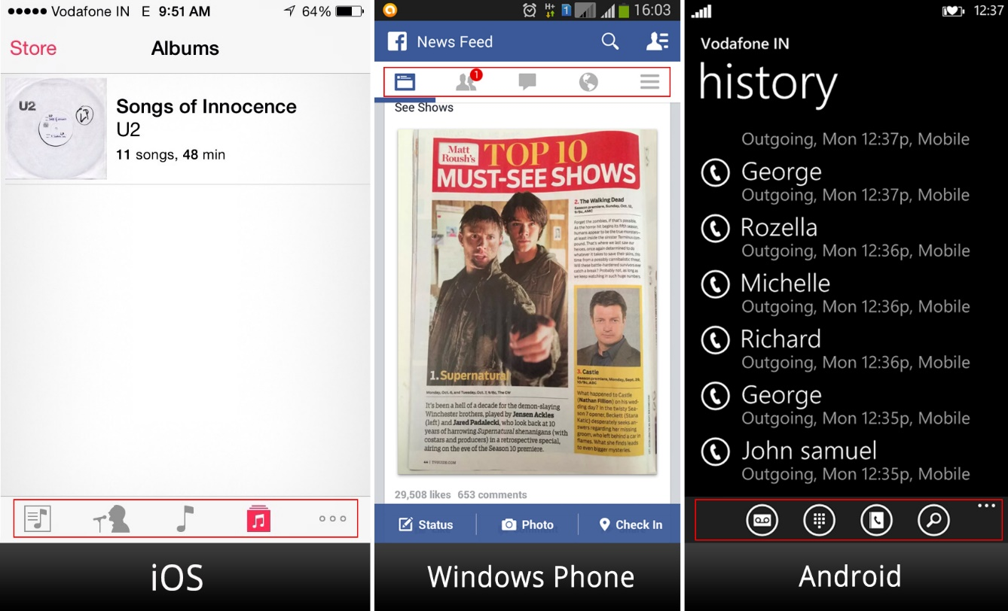
Primary Navigation Patterns (Contd.)
Persistent Navigation Patterns (Contd.)
Tab bar can be positioned either at the top or bottom of the screen.
Tab bar of Windows Phone is known as the app bar, which appears at the bottom of the screen.
Tab Bars of iOS, Android, and Windows Phone

Slide 19
Primary Navigation Patterns (Contd.)
Transient Navigation Patterns
Transient navigation patterns have evolved due to the limited screen size of a smartphone.
These patterns are temporary patterns.
Unlike persistent patterns, these patterns are not visible to mobile users at all times.
These patterns remain hidden until the users reveal them with a tap or a gesture.
These patterns are available for a short time to users only to make a selection.

Slide 20
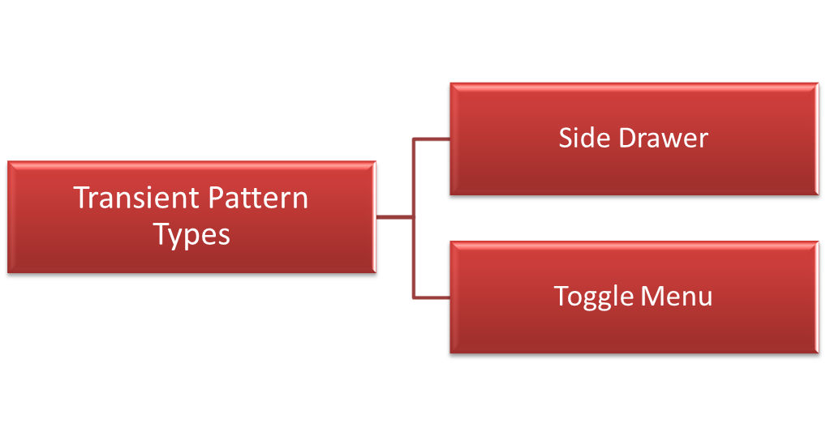
Primary Navigation Patterns (Contd.)
Transient Navigation Patterns (Contd.)
A side drawer is a panel that contains various primary options that enable users to quickly access the required information.
The side drawer does not appear at the top or bottom of the screen all the time; it appears on the screen based on users’ choice.

Slide 21
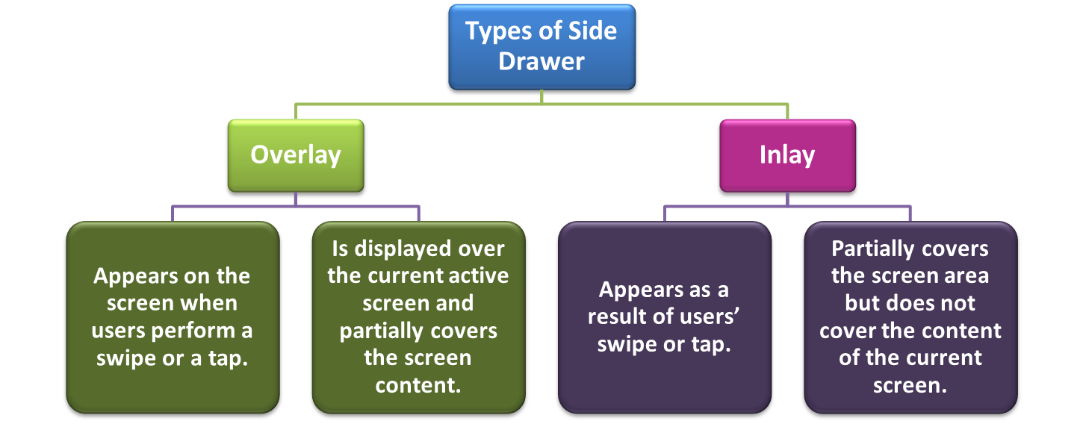
Primary Navigation Patterns (Contd.)
Transient Navigation Patterns (Contd.)

Slide 22
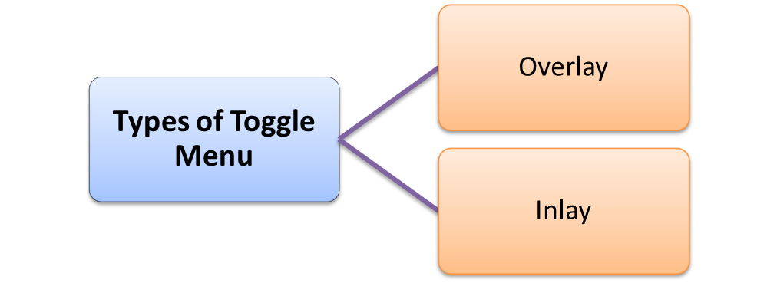
Primary Navigation Patterns (Contd.)
Transient Navigation Patterns (Contd.)
A toggle menu functions similar to a side drawer.
However, a toggle menu appears and disappears with the same gesture.
In an app, if a toggle menu appears on tapping an icon, it will disappear when the users perform the same tap gesture.
A tap on the background area behind the toggle menu also hides the menu.

Slide 23
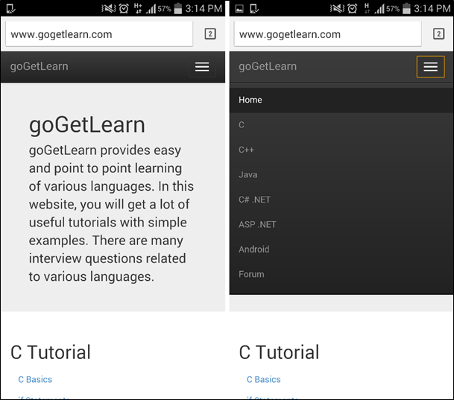
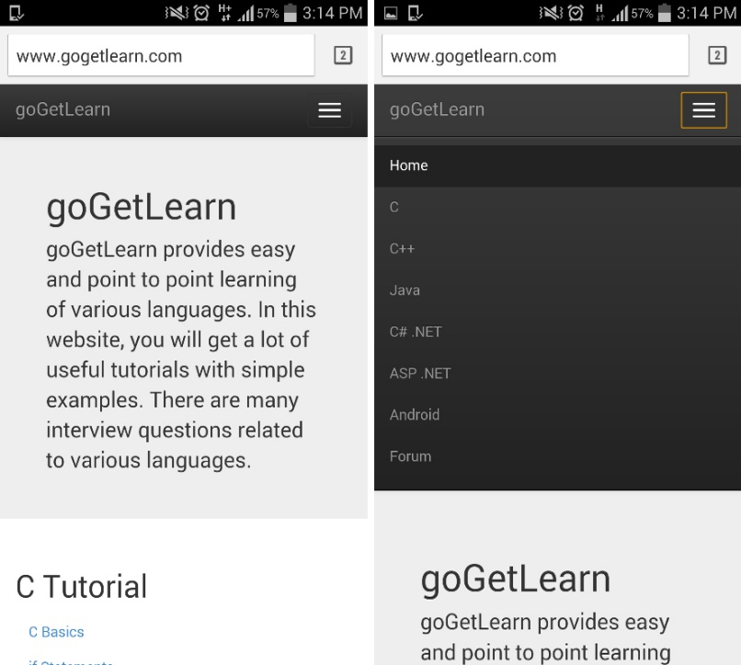
Primary Navigation Patterns (Contd.)
Transient Navigation Patterns (Contd.)
An overlay toggle menu is displayed as a layer over the current active screen content for being partially visible to users.
  An inlay toggle menu is displayed on the current active screen shifting the content in the downward direction.
Overlay Toggle Menu
Inlay Toggle Menu

Slide 24

Just a Minute
Which one of the following navigation design patterns uses a paging indicator that the user can use to view all available options?
Springboard
List menu
Accordion
Tab menu
Answer:
Springboard

Slide 25
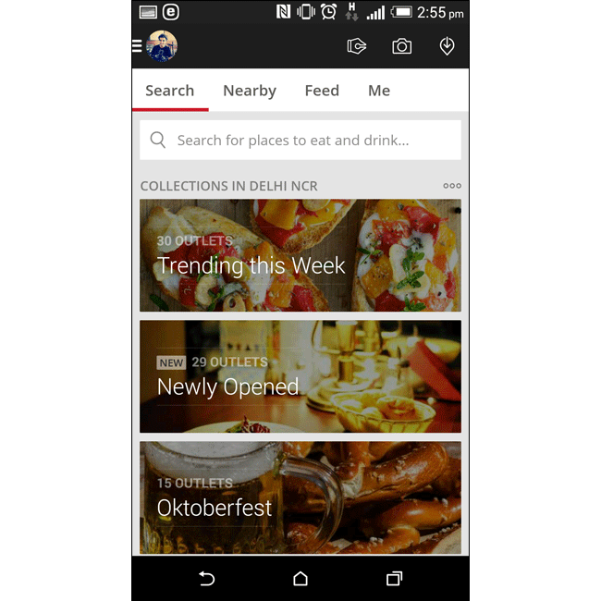
Secondary Navigation Patterns
Secondary navigation patterns are used for secondary navigation, such as menus within a page or a module.
These patterns contain menu options that enable users to navigate within a selected module.
Unlike primary navigation patterns that are available to users at the app level, secondary navigation patterns are available at the page level.
Primary navigation patterns can also be used for secondary navigation. For example, springboards can also be used for secondary navigation.
Designers can also use secondary navigation patterns for primary menus.
Secondary Navigation
Using Springboard

Slide 26
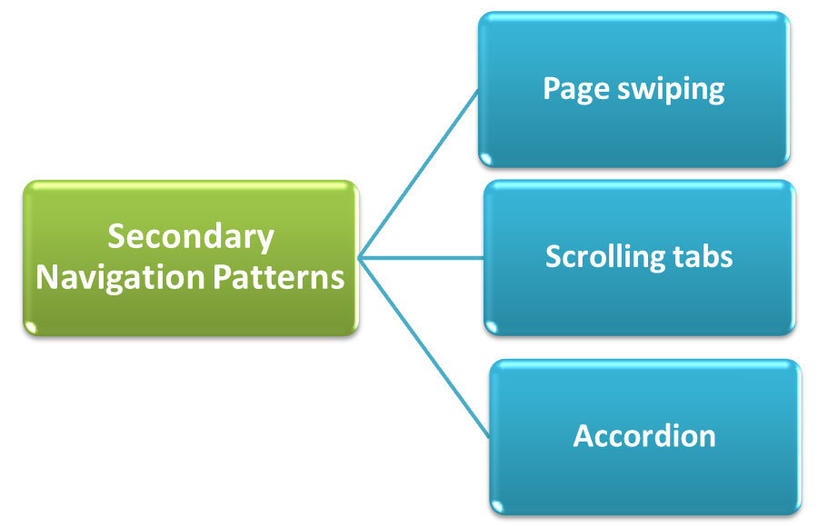
Secondary Navigation Patterns (Contd.)

Slide 27
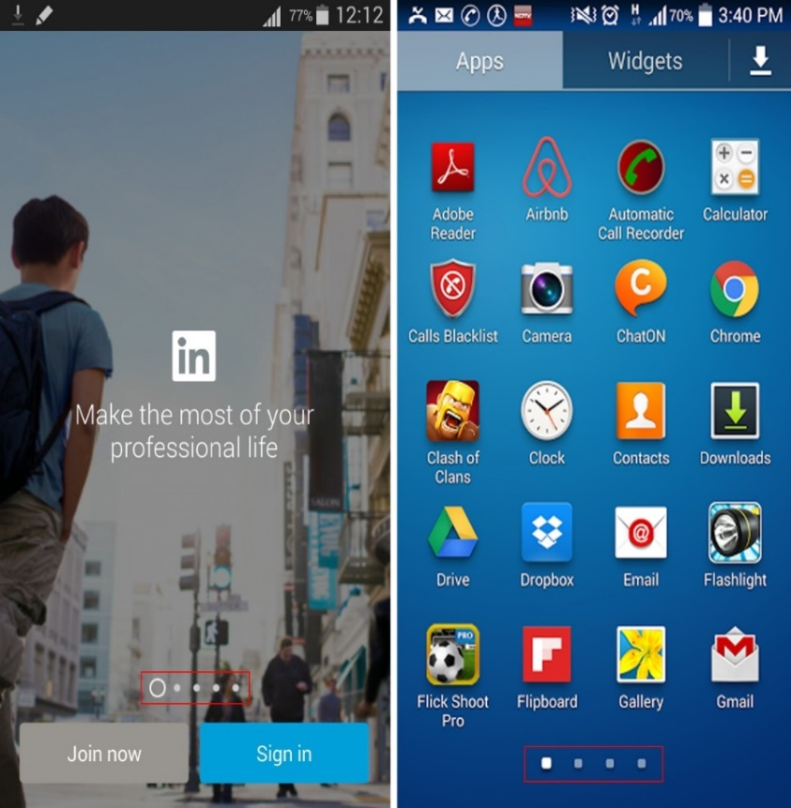
Secondary Navigation Patterns (Contd.)
Page Swiping
Page swiping functions like turning of the pages of a notebook.
Page swiping enables users to access the information spread across multiple screens through a swipe gesture.
Page indicators are displayed on the screen to indicate that there are more number of screens.
Page indicators help users to move from one screen to another.
Page Indicators

Slide 28
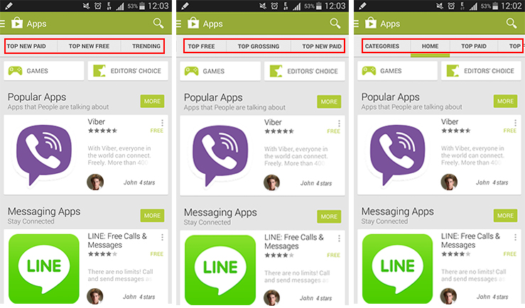
Secondary Navigation Patterns (Contd.)
Scrolling Tabs
The scrolling tabs are used where you want to enable users to access various categories of a specific module without wasting the precious screen area.
Scrolling Tabs

Slide 29
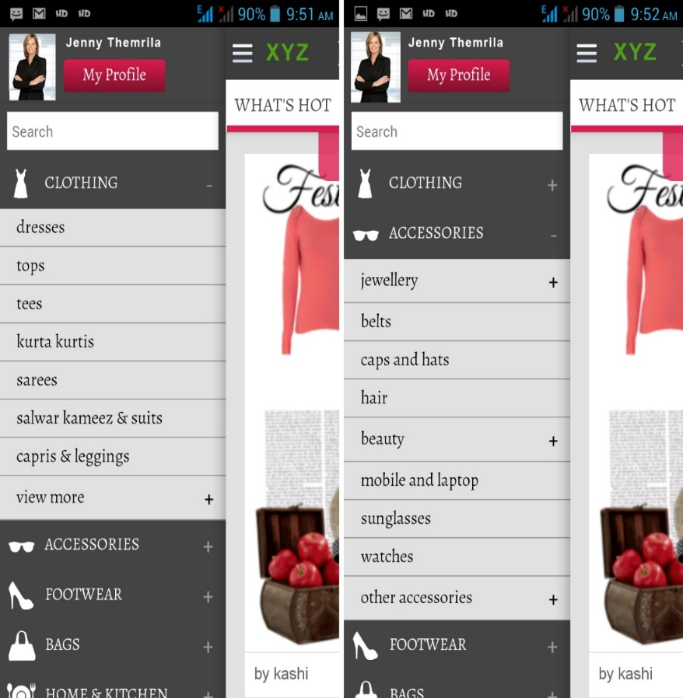
Secondary Navigation Patterns (Contd.)
Accordion
Accordion helps to design a mobile screen that can display a lot of information on the same screen.
It consists of a number of panels forming a stack.
Each panel can be expanded or collapsed whenever required.
Each panel has a meaningful name that indicates the information that the panel contains.
Accordion

Slide 30
Summary
In this session, I learned that:

